Slide 1
Milestone 1
Edwin Wu, Gio Jung, Ryan Heath, Trinity Godwin

Slide 2
Agenda
Project Specifications
Wireframes

Slide 3
Features
Required Features
Login, Registration, Game lobby/creation, Game room
Game Functionality
BS Liar’s Bar like-game
Bluffing is core to the game
Text-To-Speech (for the chat)
Rounds, Cards, Card Table, Points

Slide 4
Basic Rules of the Game
2 - 4 players, 20 cards (6 Aces, 6 Queens, 6 Kings, 2 Jokers)
Each round a card table will be designated (Ace, Queen, or King)
Each player starts with 5 cards
Each player takes turns placing any number of cards face down, which are supposedly corresponding to the card of the table
The next player can choose to call the bluff, or continue playing their cards.
If the bluff is called, then the previous player has their play revealed.
If they lied, they lose a life point.
If they didn’t lie, the player who called the bluff loses a life point.
A new round begins whenever a bluff is called.
The game continues until there is one survivor left.

Slide 5
Technologies
Express.js (Server)
Node.js (Runtime)
Postgres (Database)
Render (Cloud service)

Slide 6
Wireframes
Sign up
Log in
Game Creation/Lobby (Look for games or create one)
Game Room

Slide 7
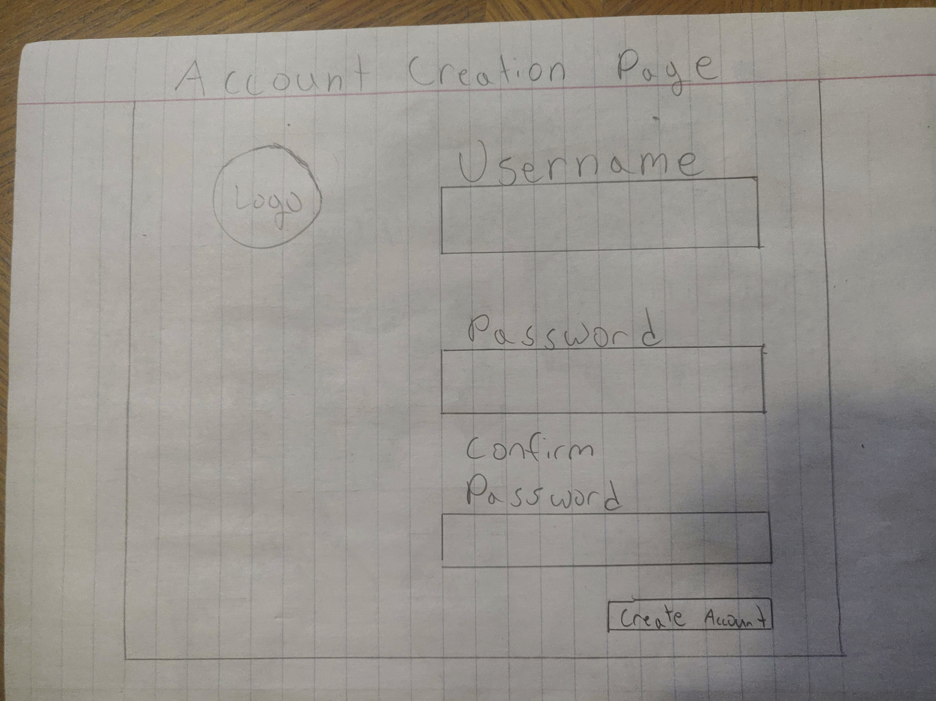
Sign Up

Slide 8
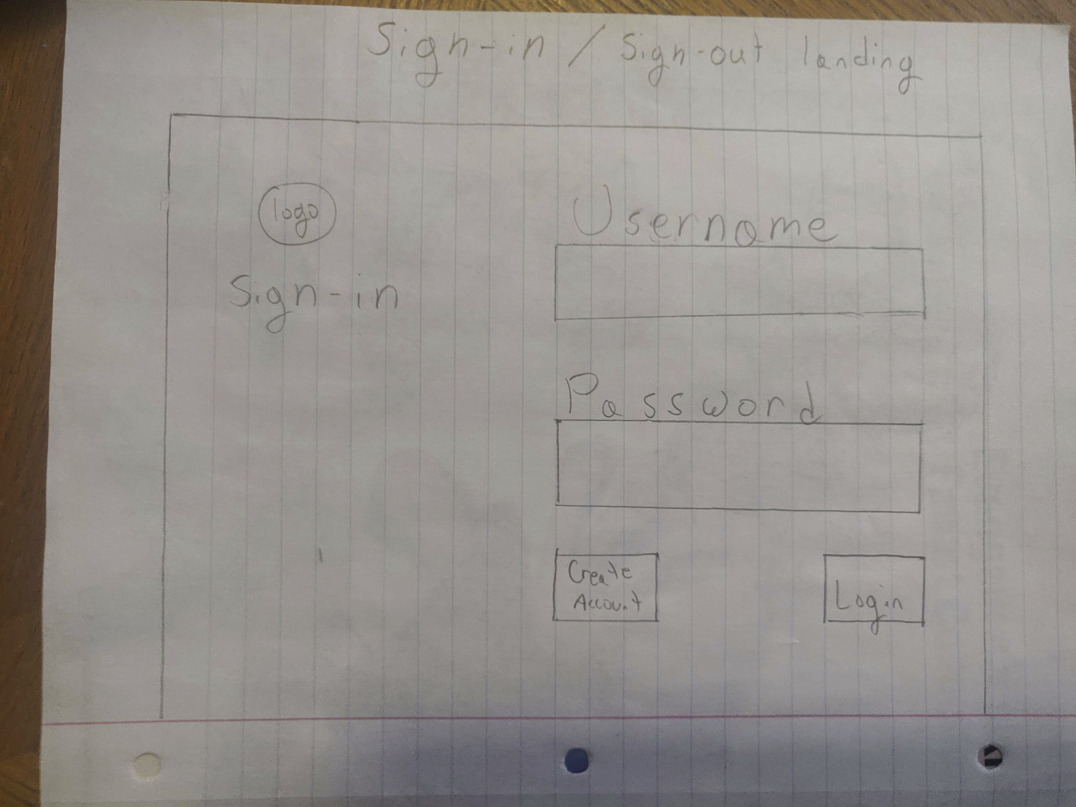
Log in / Sign-out Landing Page

Slide 9
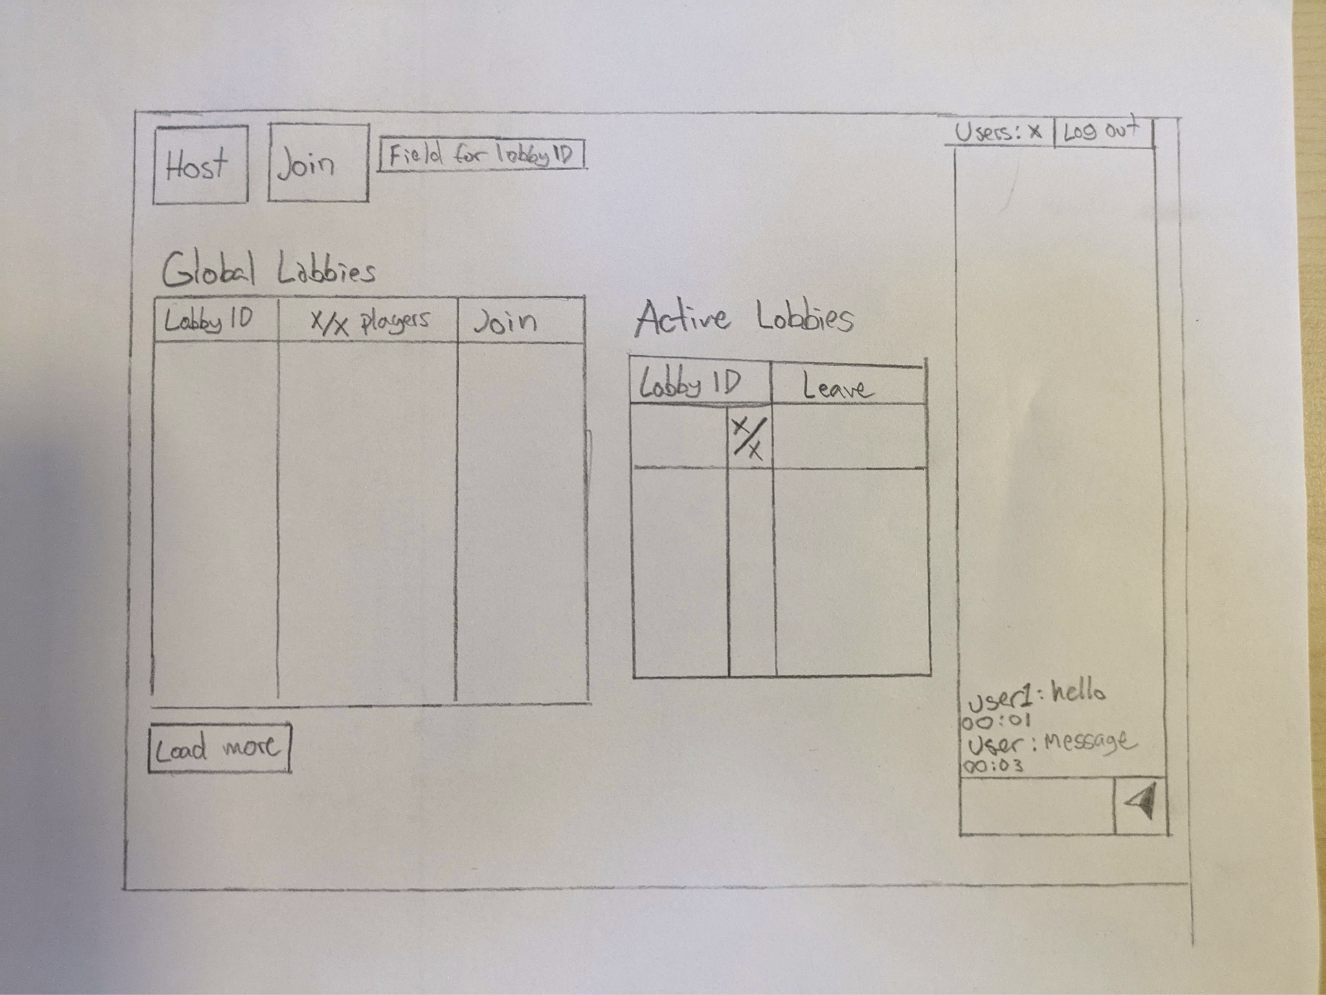
Game Creation / Lobby

Slide 10
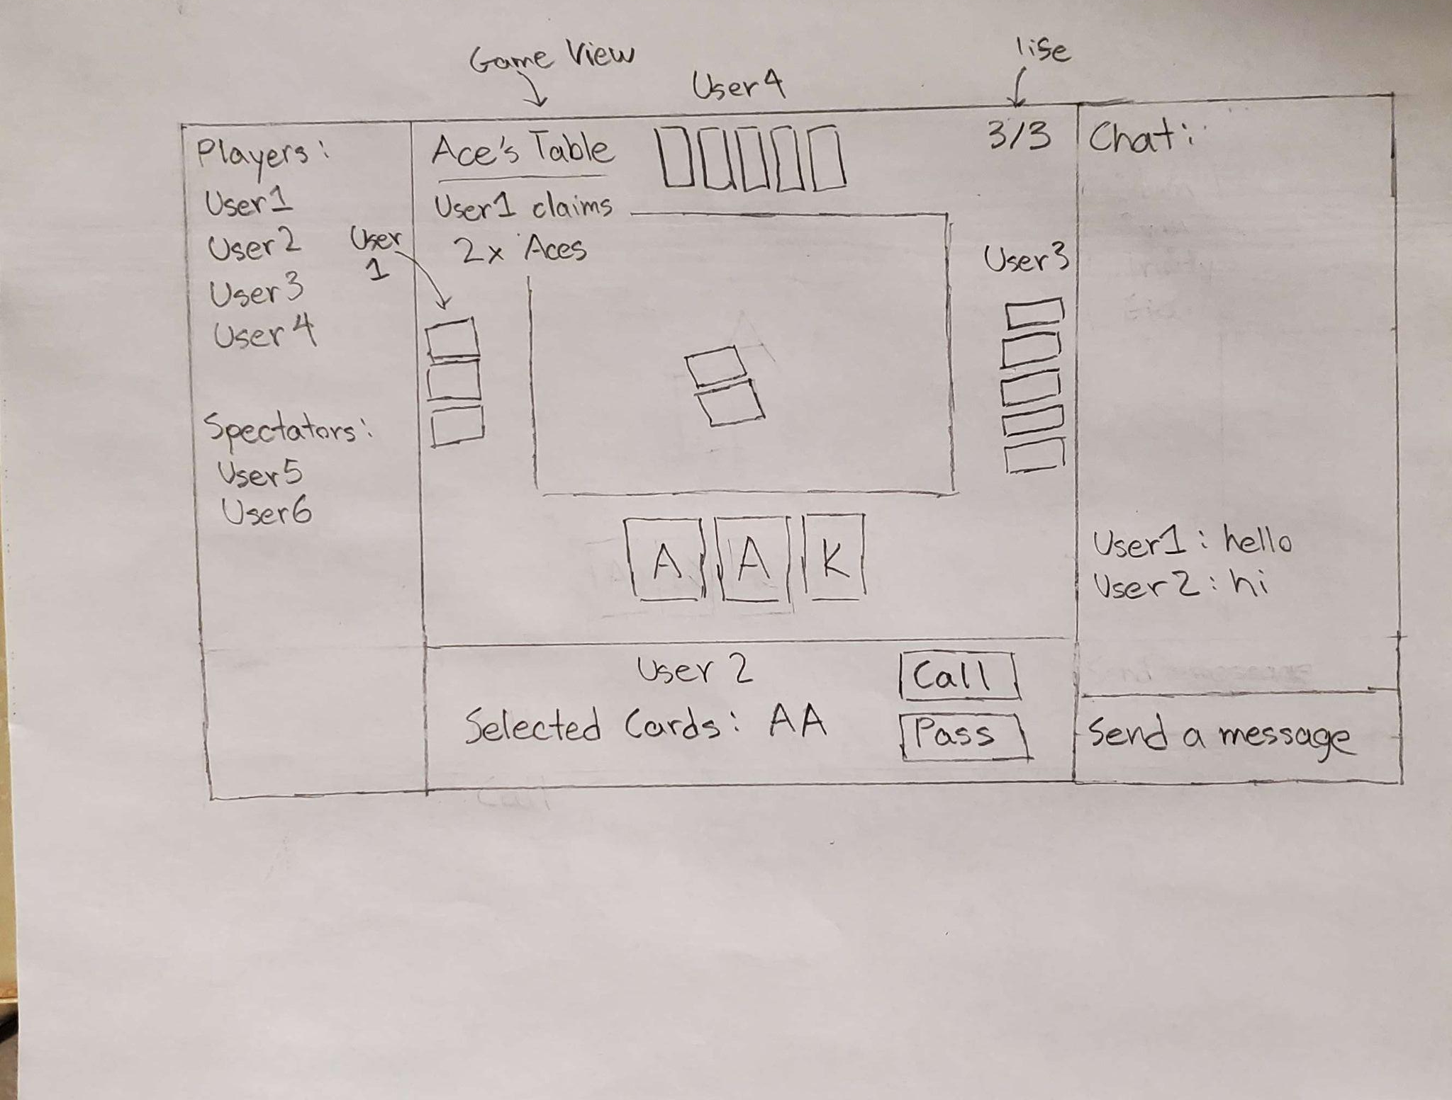
Game Room

